Slide 1
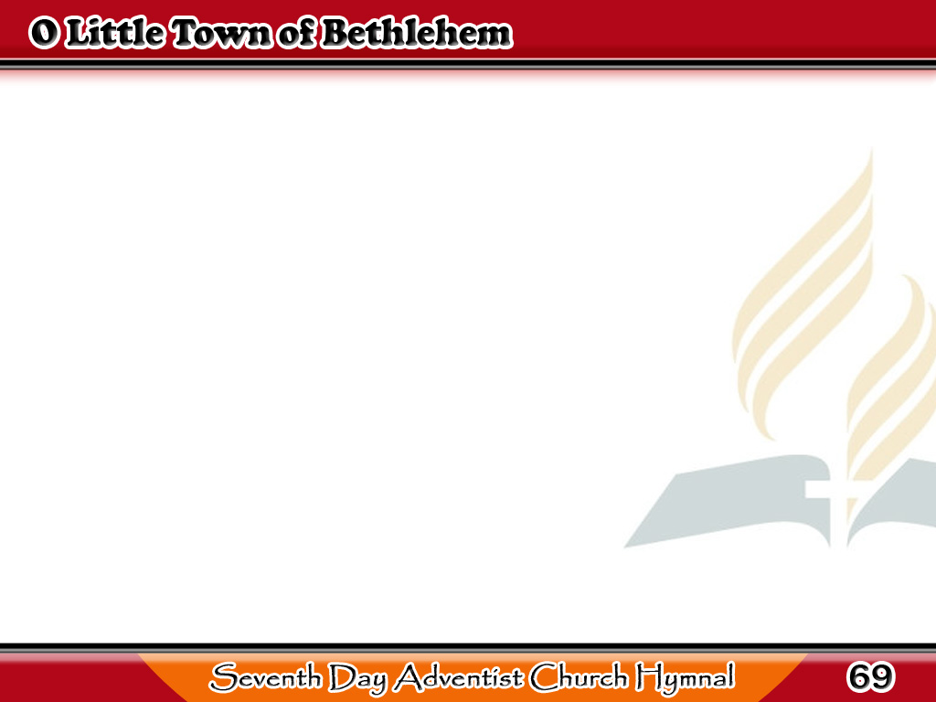
O Munting Bayang Bethlehem
O little town of Bethlehem,
How still we see thee lie!
Above thy deep
and dreamless sleep
The silent stars go by;
1/4

Slide 2
O Munting Bayang Bethlehem
Yet in thy dark streets shineth
The everlasting light;
The hopes and fears
of all the years
Are met in thee tonight.
1/4

Slide 3
O Munting Bayang Bethlehem
For Christ is born of Mary;
And gathered all above,
While mortals sleep,
the angels keep
Their watch of wondering love.
2/4

Slide 4
O Munting Bayang Bethlehem
O morning stars, together
Proclaim the holy birth!
And praises sing to God the King,
And peace to men on earth.
2/4

Slide 5
O Munting Bayang Bethlehem
How silently, how silently
The wondrous gift is given!
So God imparts to human hearts
The blessings of His heaven.
3/4

Slide 6
O Munting Bayang Bethlehem
No ear may hear His coming;
But in this world of sin,
Where meek souls
will receive Him still,
The dear Christ enters in.
3/4

Slide 7
O Munting Bayang Bethlehem
O holy Child of Bethlehem,
Descend to us, we pray;
Cast out our sin and enter in
Be born in us today.
4/4

Slide 8
O Munting Bayang Bethlehem
We hear the Christmas angels
The great glad tidings tell
Oh, come to us, abide with us,
Our Lord Immanuel.
4/4

